Slide 1

Trail formation
Michael Mattmann and Riccardo Schira

Slide 2
Introduction
Motivation: The planning of trails and streets in a park is an important issue in the planning of an entire park.
What we did: We have simulated some simple situation and tryed to explain the results of theme. In the second part we have taken some real parks and looked if the planning of them had been made in a good way, or if there’s a potential of improvement.

Slide 3
Fundamental questions
How do trajectories form?
What is the final network of the most common sets of entrance / exits?
How does topology influence the final network?
How would the system of trails of a real park change over time if the existing ”trails” will be no longer asphalted?
Notes:
Common sets: square, cross, existing streets, …

Slide 4
The Model 1
We considered:
Presence of trails
Slope of the ground
Regeneration of nature
Direction of target
We didn’t considered:
Social forces
Inertia of pedestrian

Slide 5
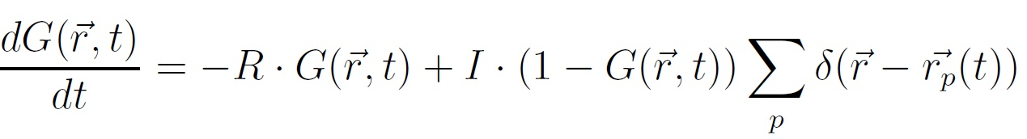
The Model 2
Equation of ground:
Regeneration of nature
Footprints left by pedestrians

Slide 6
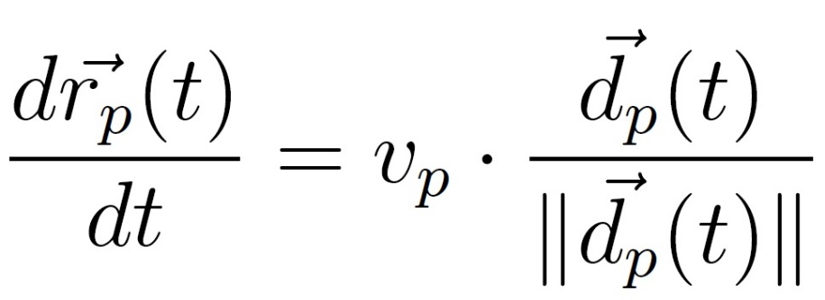
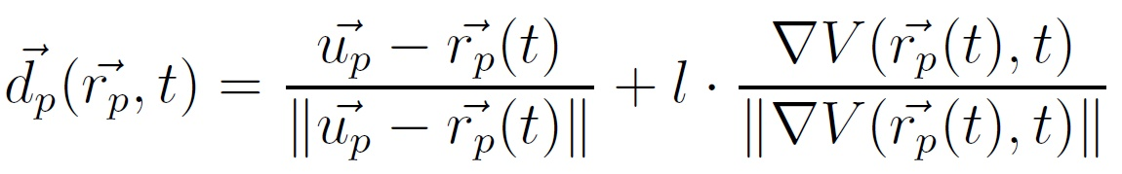
The Model 3
Equation of motion:
Direction of the target
Most comfortable direction

Slide 7
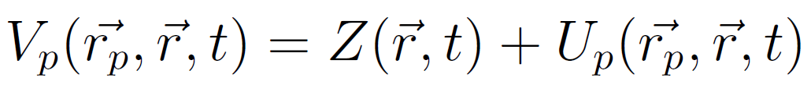
The Model 4
The potential:
Presence of tracks in the neighborhoods
‘Slope’ of the ground

Slide 8
Implementation 1
Discrete → Matrix:
Cells: 1x1m
Ground
Topolgy
Potential
Pedestrian position
Pedestrian: vector:
Entrance coordinate
Exit coordinate

Slide 9
Implementation 2
Scripts:
‘start.m’
‘main.m’
’insert_person_N_entrance_N_exit.m’
’direction_pend.m’
’move_person.m’
’change_ground.m’

Slide 10
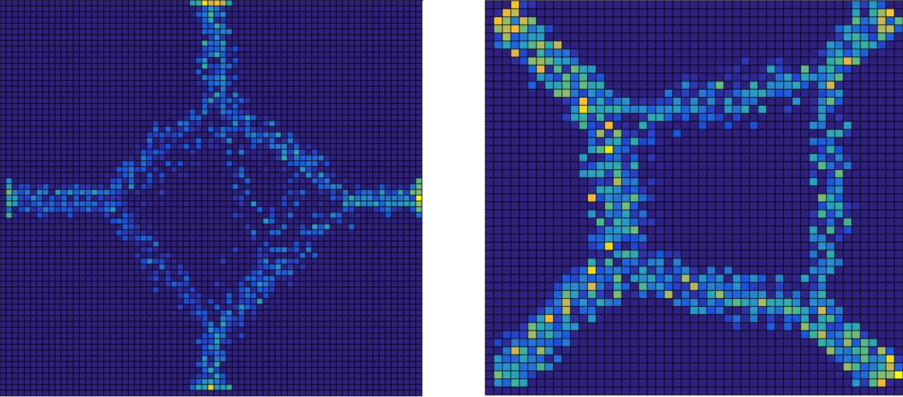
Most common set of entraces / exits
Notes:
Here two exeples of simulations performed on an ideal set of entrancel exits.
All with the same probability
The results were the one expected

Slide 11
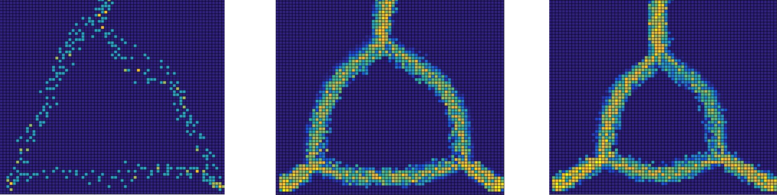
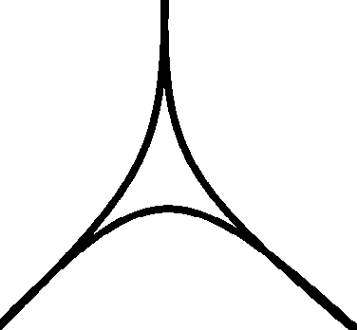
Most common set of entraces / exits
It was the only simulation that gave us a different result from what we expected.
Notes:
Simulatio on an idealized triangle
The result differed from what we expected, it may be due to the fact that our model does not consider the “inertia” of peoples (in reality no one makes this 90° angle) while walking)
This triangle kan be found also in a simulation of a real park …. It worke better

Slide 12
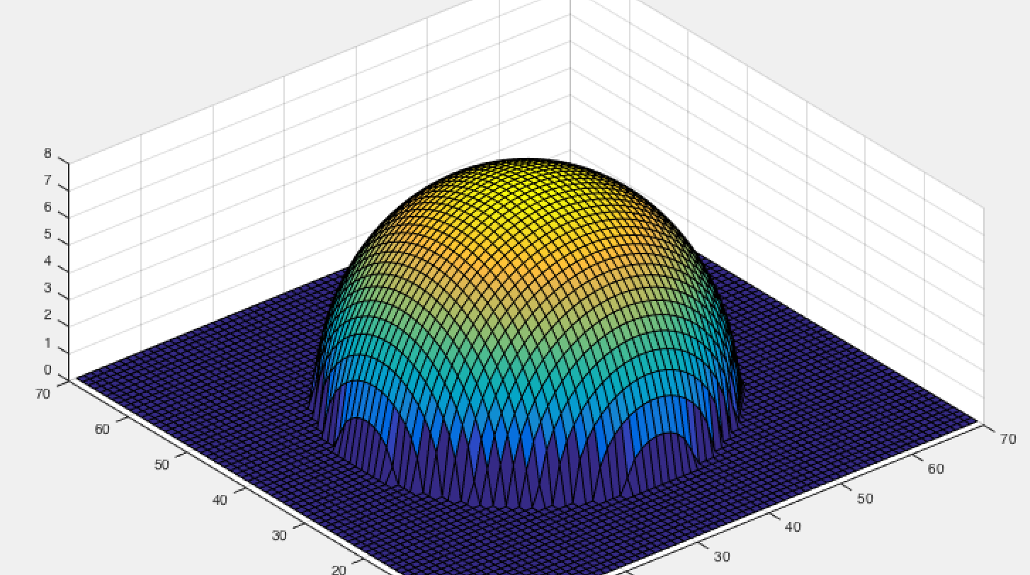
Some simulations with topology
Notes:
Not many simulation on topology
It worked good on the idealized situation but on real park it was difficult to finde exact topology datas

Slide 13
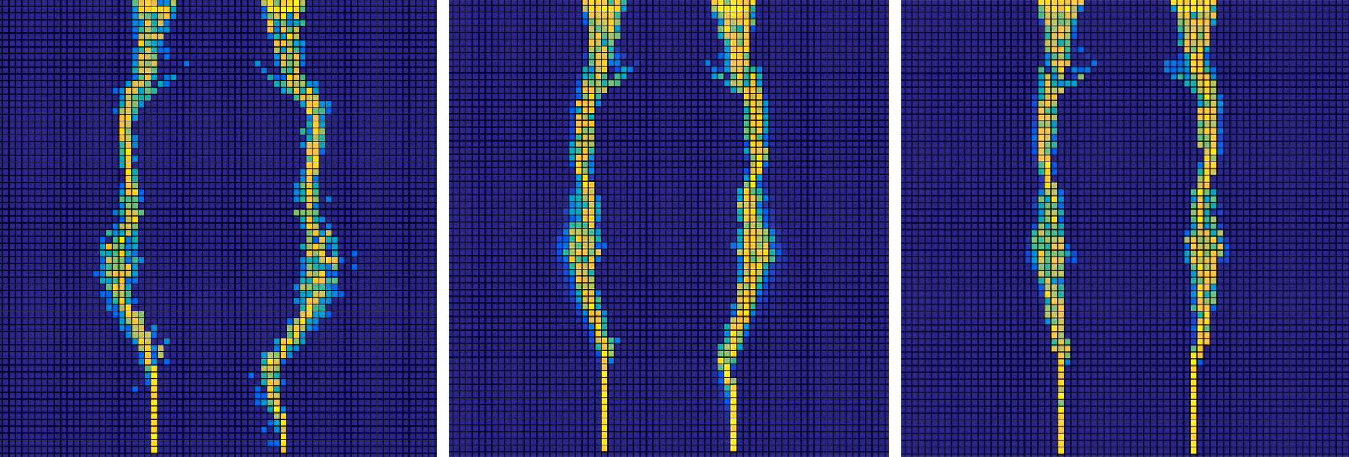
Some simulations with topology
Notes:
Not many simulation on topology
It worked good on the idealized situation but on real park it was difficult to finde exact topology datas
Peoples went around the dome in the middle but in the end went ower it
We assume that this is due to the attraction of the two streets

Slide 14
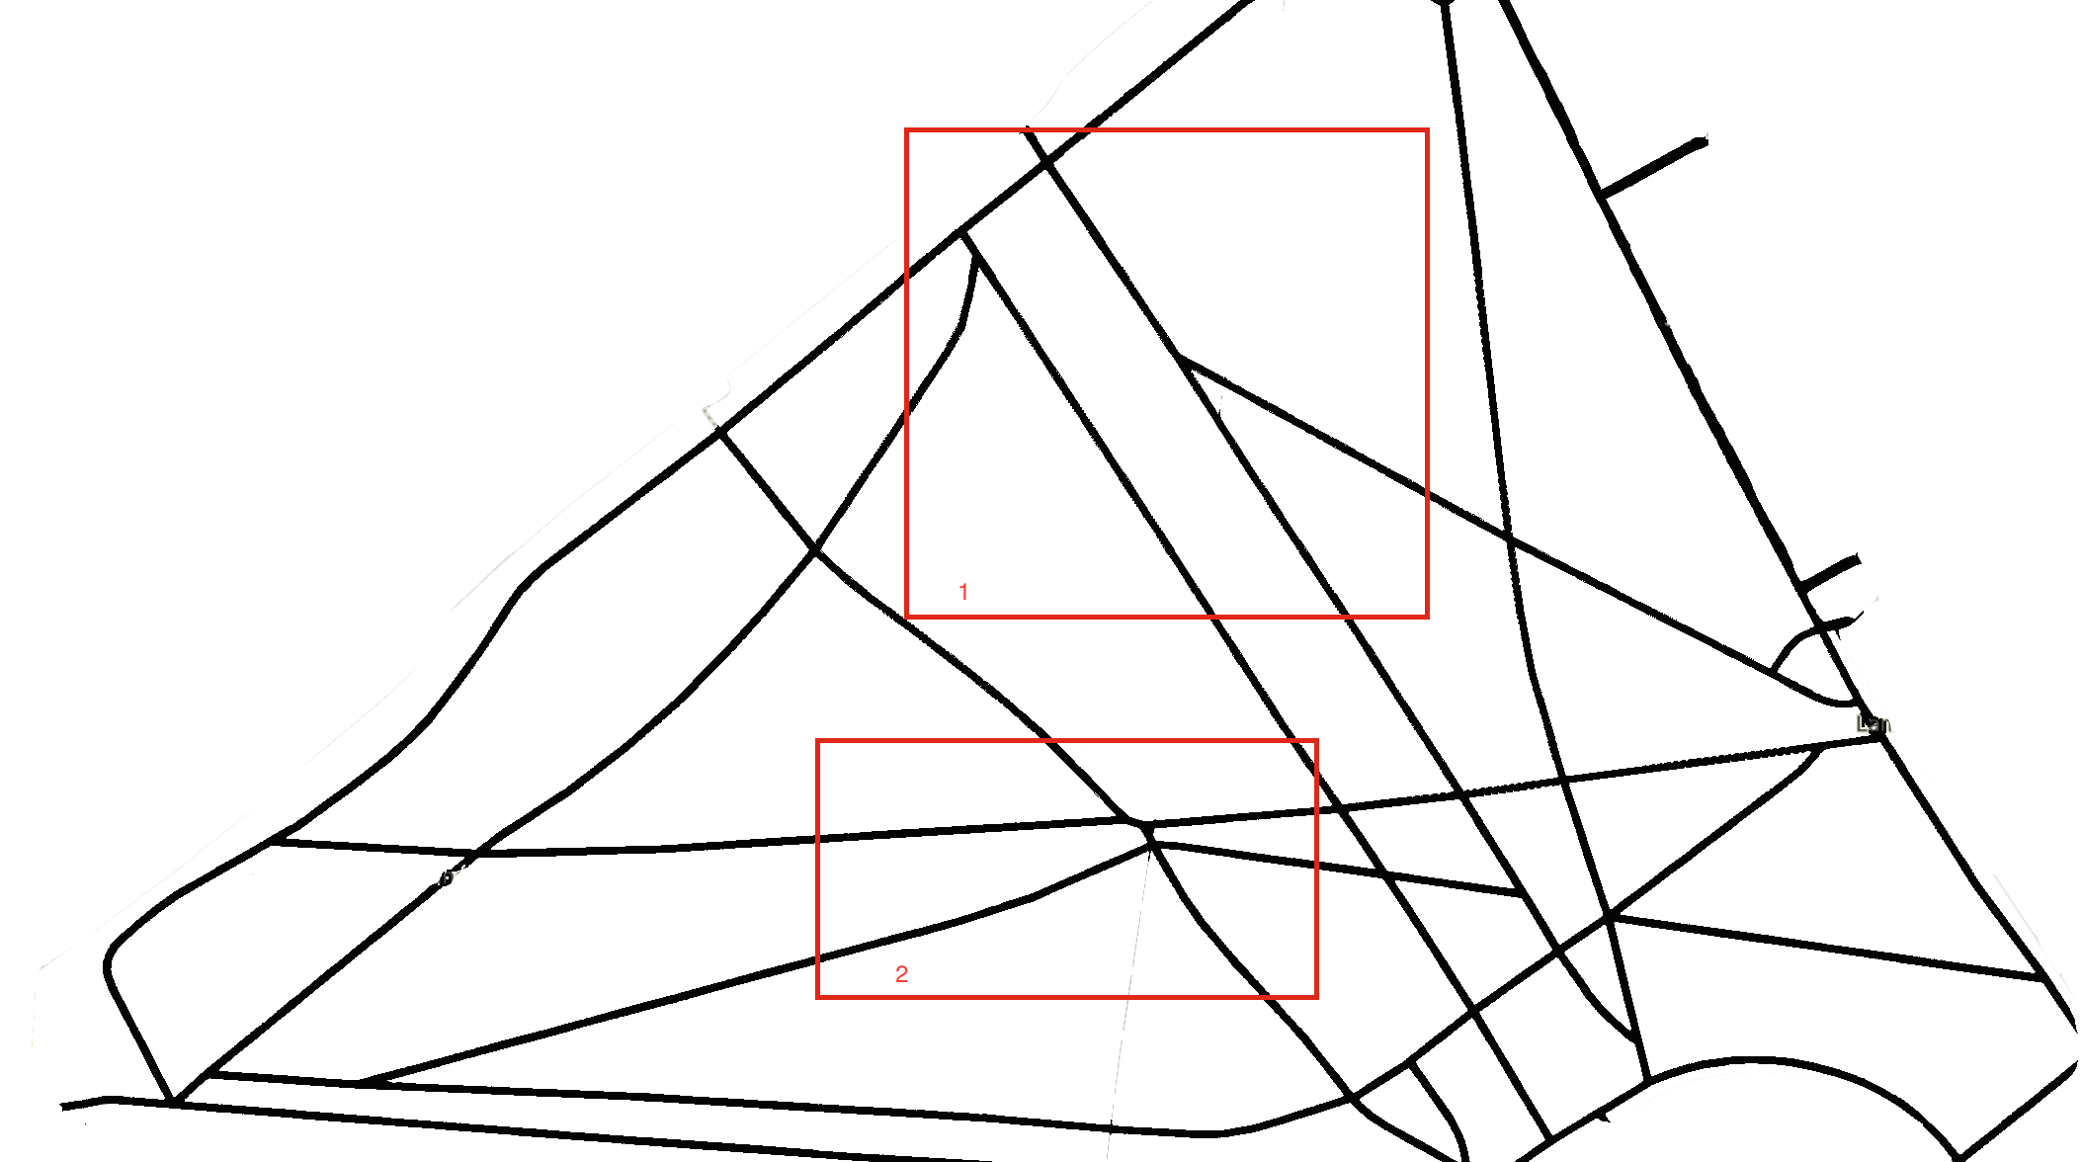
Real Park I: Green Park
Notes:
Slow model
Only simulations on single parts of the park (tot. 2 sim)

Slide 15
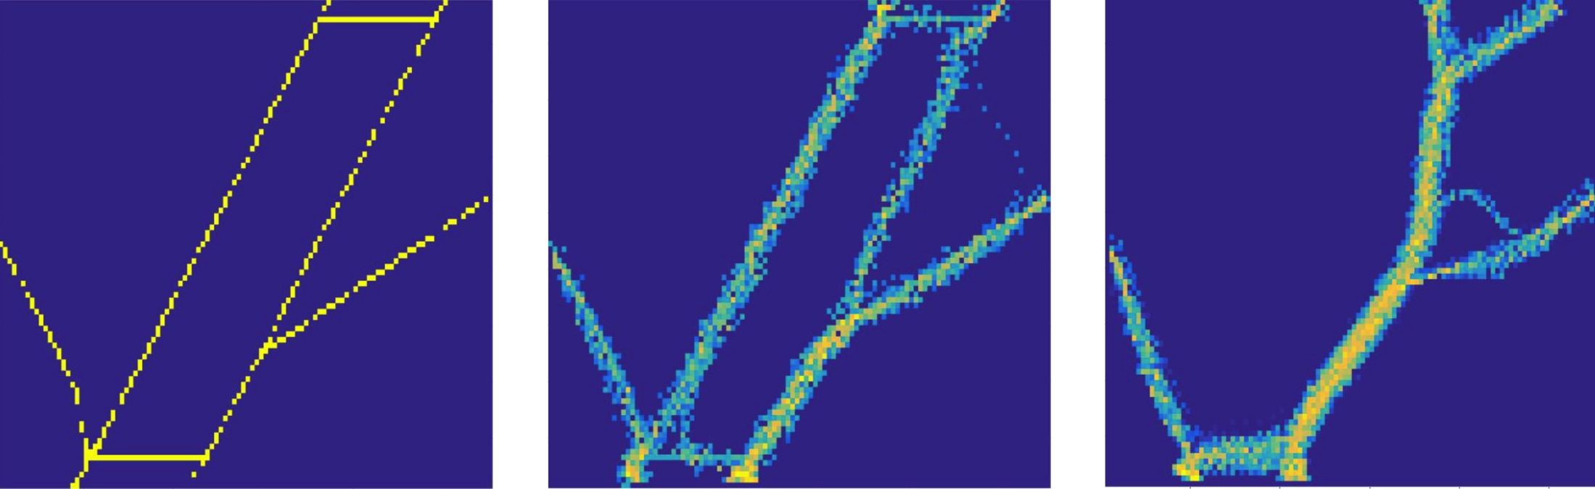
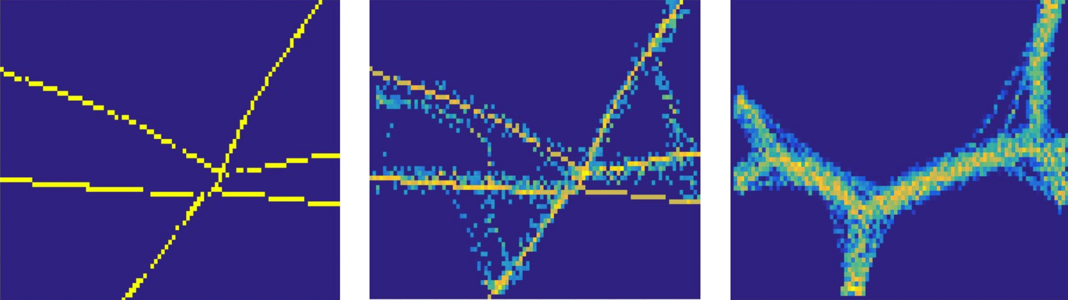
Real Park I: Green Park
Notes:
Firs: follow existing streets and than create new ones
Second: don’t follow existing streets and direct creation of new network
End: in both similar result (big street with links to enrance/exit)

Slide 16
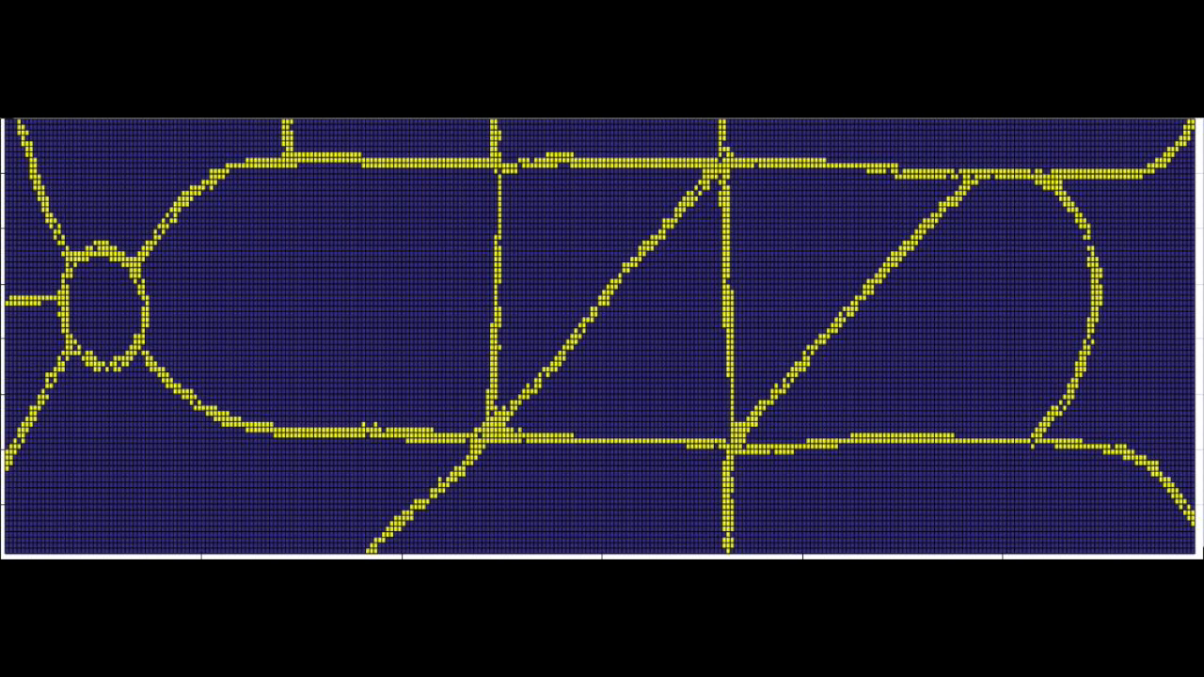
Real Park II: Joyce Park
Notes:
First modification on the left roun -> not possible because of fountaine
Faster change on the left side of the park and slow on the right
See the triangle on the right at the end

Slide 17
Summary
We had a lot of fun implementing our model and learning to use Matlab
Unfortunately our model become very slow an in the end we had to wait a lot till all simulation performed. This part was a little bit bording and redused our motivation in this work.

Slide 18
Outlook
The target of an coming project could be to make the model more realistic and faster. Some suggestions:
Take into account that on certain areas of a park can’t be walked on
Implement also a ”social-force” model.
Search more accurately for data about the percentage of pedestrians entering and going out by the single entrance/exit.

Slide 19
Questions?

